Slide 1
Problem Statement Worksheet (Hypothesis Formation)
Big Mountain Resort planning to increase the revenue by cutting cost or by increasing ticket price in Montana region by year end.
H
1
Context
4
Constraints within solution space
Big mountain resort is located in Montana who offers spectacular views and ski for levels. Big Mountain recently installed an additional chair life to increase the distribution of visitors across mountain, which increased their operation cost by $1540000. Company is planning to increase the revenue by increasing the ticket price or by capitalizing their resources by 100%.
Identifying the less capitalize resources and look for threshold, by which we can increase the ticket price.
2
Criteria for success
5
Stakeholders to provide key insight
Jimmy Blackburn – Director of operations, Alesha Eisen – Database Manager.
Increase the revenue by capitalizing their resources or increase the ticket price.
3
Scope of solution space
6
Key data sources
The CSV file received by Database Managers and some key columns to look for. Columns as follows:
Adultweekday ticket price, Adultweekend ticket price, total number of chairlift with other ski resort,Skiable terrain area, longestrun_mi, NightSkiing_ac
Utilizing the existing resources to bridge the gap between operational cost and income. In turn it will increase the revenue.
H
D
E
I
P
Notes:
Hypothesis: Create a Hypothesis with an emphasis on SMART principles. (S – Specific, M – Measurable, A – Achievable, R – Realistic, T – Timebound). If you cannot do this, you do not have a good grasp on the business problem.
Context: With context, we have clearly identified the problem at hand and have elucidated on how our initiative may solve this problem, alongside the commercial implications this will have on the business.
Criteria for Success: Clearly defining the criteria for success ensures that the scope of your work is clearly defined and understood. Otherwise, if this isn’t defined – your work will never end which will result in mismatched expectations.
Scope of Solution Space: Scoping out the solution space ensures that the business initiative is SPECIFIC for a certain segment or area. This prevents solutions that have been developed being scaled and applied for all other business units that the solution may not be responsible or scalable for.
Constraints within Solution Space: Looking forward, what are the foreseeable problems we are likely to encounter? Could this be stakeholder resistance? Could this be we don’t have access to the right data?
Stakeholders to provide key insight: Who are the people I need to speak to, to get the answers I need for my data analysis?
What key data sources are required?
Based off my discussions with the key stakeholders – can we clearly list out all the data sources we need so we can make a highly targeted request as opposed to a scatter-gun approach where we ask for a bit of everything?

Slide 2
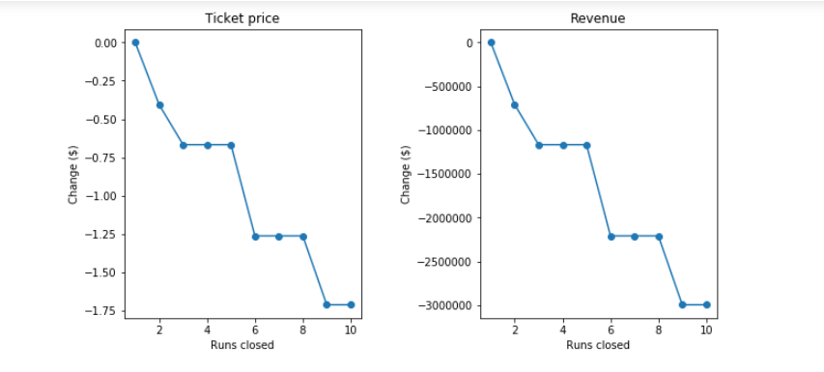
Recommendations and Key findings
Based on my analysis, Big Mountain resort can permanently close up to 5 least used runs. Because closing more than 5 runs will lead to larger drop in revenue. Attaching plot below to support my recommendation:
From above plot we can see that, closing more than 5 runs have drastic effect on revenue.

Slide 3
Modelling results and analysis
At our initial analysis, based on our model, it suggested to increase the ticket from $81 to $95.87 with mean error of $10.39, which suggest that there is a room for a price increase. Even we see the facilities being provided by Big mountain is well above than other competitor in the market, which we can showcase using below pictorial analysis.
There feature which are the important deciding factor in setting the ticket price and our model showed that, Big Mountain is on higher league in terms of providing all facilities. Let me introduce all the important feature and where Big Mountain lies.
Snow making area:

Slide 4
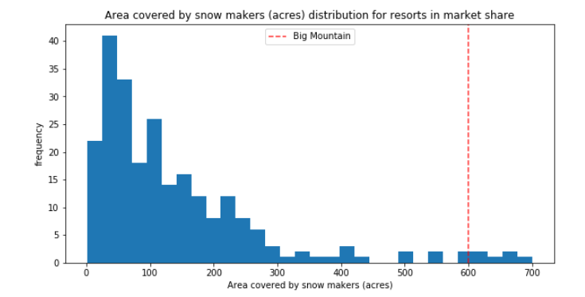
Fig: Comparison of snow making area
We can see Big Mountain is very high up the league table of snow making area.

Slide 5
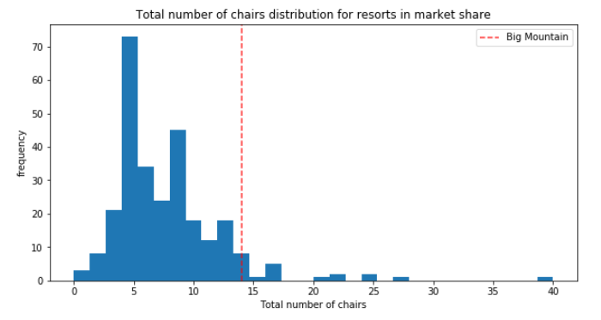
Total No of chairs
Big Mountain has amongst the highest number of total chairs, resorts with more appear to be outliers.

Slide 6
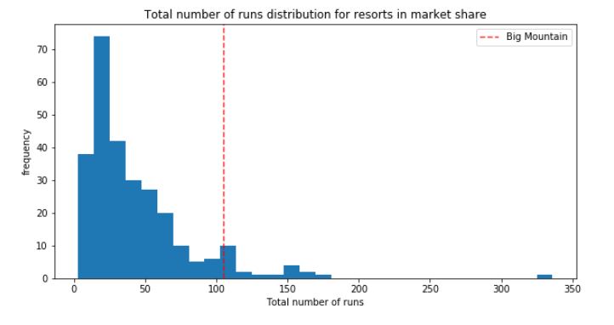
Runs
Big Mountain compares well for the number of runs. There are some resorts with more, but not many.

Slide 7
Summary and conclusion
Based on my analysis, I can say our client Big Mountain is way ahead in providing the different facilities and amenities to their customer in comparison to another ski resort, Which put Big Mountain on premium segment in ski resort market. Keeping all facilities list I suggest Big Mountain resort to increase the Ticket Price from $81 to $90.

